Slide 1

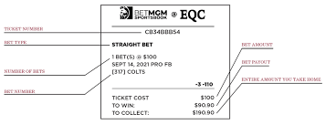
Pro Odds
One of the best ways to find value in your sports betting picks is by comparing lines from multiple sportsbooks. This website will make NFL gambling analysis easier for users by showing lines from popular sportsbooks in the USA.

